Slide 1
Thermal imaging and SMS alert for farmers
Ninad Mehendale

Slide 2
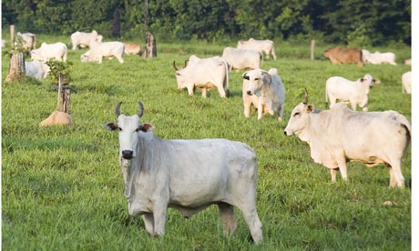

Slide 3
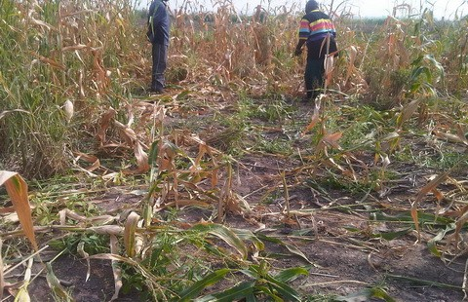
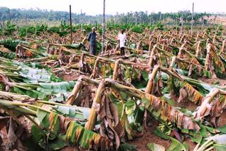

Slide 4
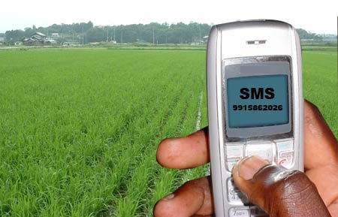

Slide 5
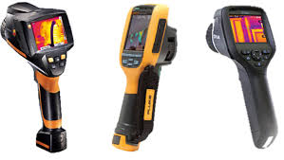
Thermal sensor
A thermographic camera (also called an infrared camera or thermal imaging camera) is a device that forms an image using infrared radiation, similar to a common camera that forms an image using visible light. Instead of the 450–750 nanometer range of the visible light camera, infrared cameras operate in wavelengths as long as 14,000 nm (14 µm).

Slide 6
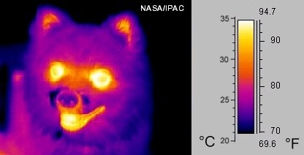

Slide 7
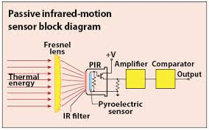

Slide 8
Power Supply
Passive heat signature detector
Signal conditioning circuit
Analog to digital converter
Relay driver
Relay
Microcontroller
Buzzer
GSM Module

Slide 9
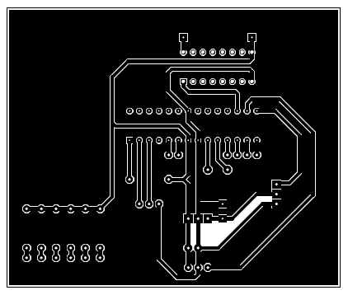

Slide 10
