Slide 1
WiMax
Ninad Mehendale

Slide 2
WiMax
WiMAX (Worldwide Interoperability for Microwave Access) is a wireless communications standard designed to provide 30 to 40 megabit-per-second data rates, with the 2011 update providing up to 1 Gbit/s for fixed stations.

Slide 3
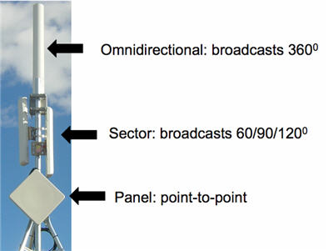
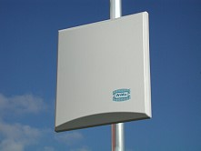
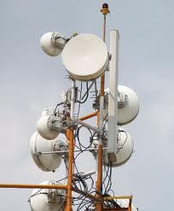
Existing WiMax antennas

Slide 4
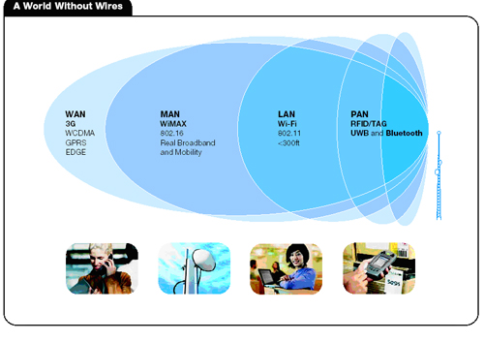
Wireless

Slide 5
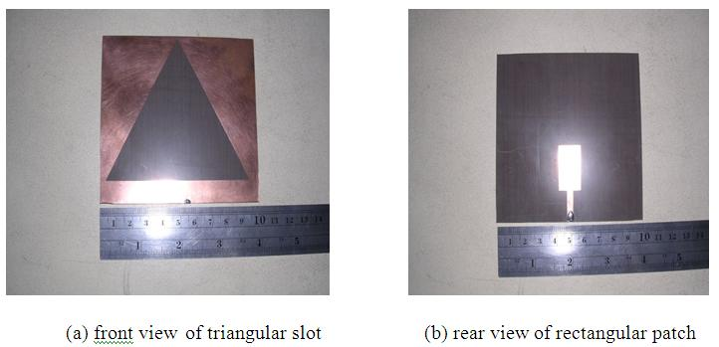
Proposed system

